Slide 1


Vishwabhushan Foundation
Corporate Social Responsibility (CSR) Proposal
Dr. Sachin Bhosale
Report Date：22.01.25

Slide 2
Contents
1.
Introduction
2.
Presidential Remarks
3.
Trustee Board
4.
Vision and Mission
5.
Unique Activities (2018-2024)
6.
Audit of Extension and Outreach Activities
7.
Awards Given for Different Categories
8.
Income Statement
9.
Research Grants Awarded
10.
E-Book Publication Summary
11.
Online Workshop Seminar Conducted
12.
Visits of Renowned Persons
13.
Proposed Initiatives
14.
NGO Document Details
15.
Conclusion
16.
Contact Information

Slide 3

Introduction
01

Slide 4
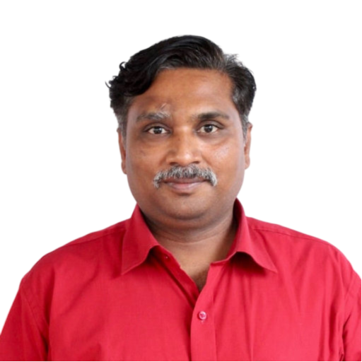
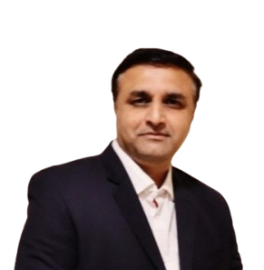
Foundation Overview
Established in 2018
Dr Sachin Bhosale
President
Established by Dr. Sachin Shankar Bhosale
Not- for- profit organization
Dr Rajendra Patil
Executive Director
Member of Ad-Hoc Board of Studies,
Member of Editorial Board,
Member of Exam Committee,
Research Guide,
Book Author.
AI Consultant ACLP certified (Singapore) Corporate Trainer,
Prompt Engineer Transformation Lead-Academics,
Leading Corporate L&D initiatives, Advisor for Startups.
Dedicated to the holistic development of the Nimgaon Jali community
Focuses on charitable activities, education, humanitarian efforts, cultural initiatives, religious endeavors, and physical development of society

Slide 5
02
Presidential Remarks
Executive Directors Remark
"The Vishwabhushan Foundation is dedicated to creating sustainable change in education, healthcare, and community development. Our work is driven by a commitment to empower the underprivileged and foster holistic growth. Together, with the support of our team and community, we aim to build a brighter and more inclusive future for all. Let us continue to inspire positive change and contribute to the betterment of society with unwavering dedication.“
- Dr. Sachin Bhosale
"I am proud to support the Vishwabhushan Foundation's mission of empowering communities through impactful programs in education, health, and development. Together, we are building a brighter, sustainable future. Our efforts are rooted in creating opportunities for the underprivileged and fostering holistic growth. With continued collaboration and dedication, we can make a lasting difference in the lives of many.“
- Dr. Rajendra Patil

Slide 6

Dr. Sachin Shankar Bhosale
Mission to provide sustainable solutions and opportunities for growth
Commitment to High-Impact Programs
Targets underprivileged sections in healthcare, education, research, and socio- economic development

Slide 7

Trustee Board
03

Slide 8
Board Composition
Details of Trustees
01
Dr. Sachin Shankar Bhosale, President
05
Mr. Mahesh Shankar Bhosale, Trustee
02
Mr. Shankar Sawaleram Bhosale, Vice President
06
Mrs. Lata Shankar Bhosale, Treasurer
03
Mrs. Vaishali Bhimraj Kadam, Trustee
07
Dr. Vijaya Sachin Bhosale, Secretary
04
Mrs. Anuradha Suresh Mantode, Trustee
08
Dr. Rajendra Patil,
Executive Director

Slide 9

Advisory Body
Advisory Members
01
02
03
Dr. Hiren Dand, Convener
Dr. Rajendra Patil, Member
Dr. Tushar Sambare, Member
05
04
Mr. Shrikant Kekane, Member
Mr. Rahul Godbole, Member

Slide 10

Vision and Mission
04

Slide 11

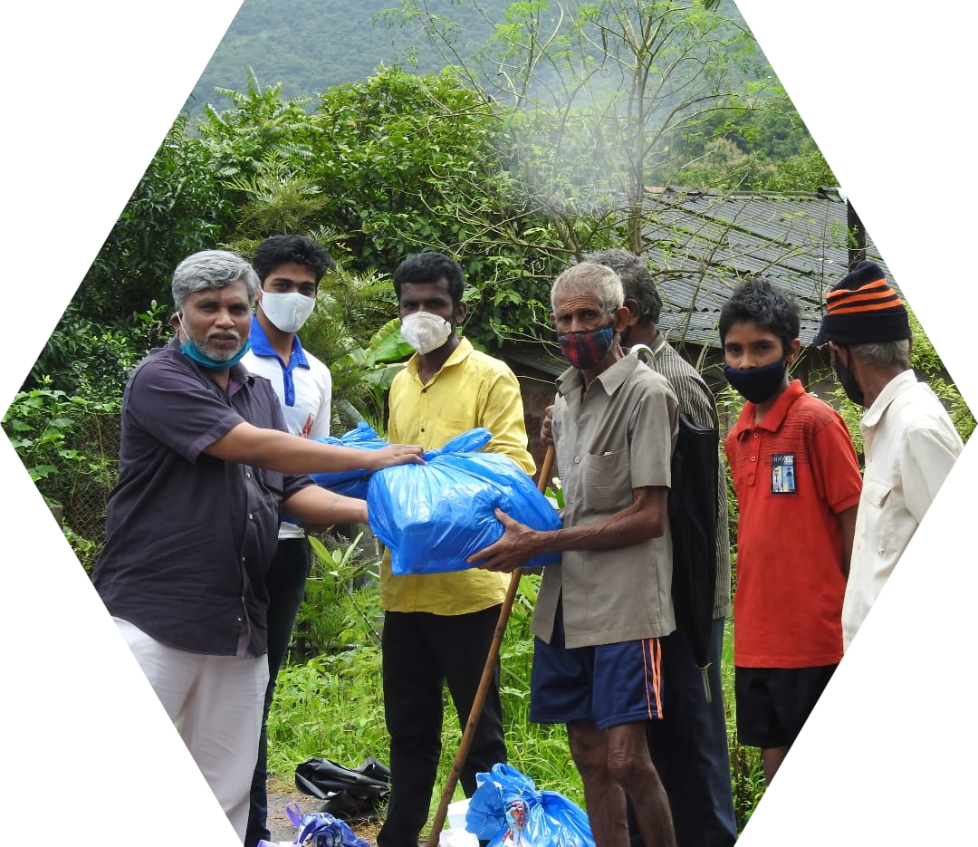
Vision
Holistic Empowerment
Create a society where holistic development empowers individuals and communities

Slide 12

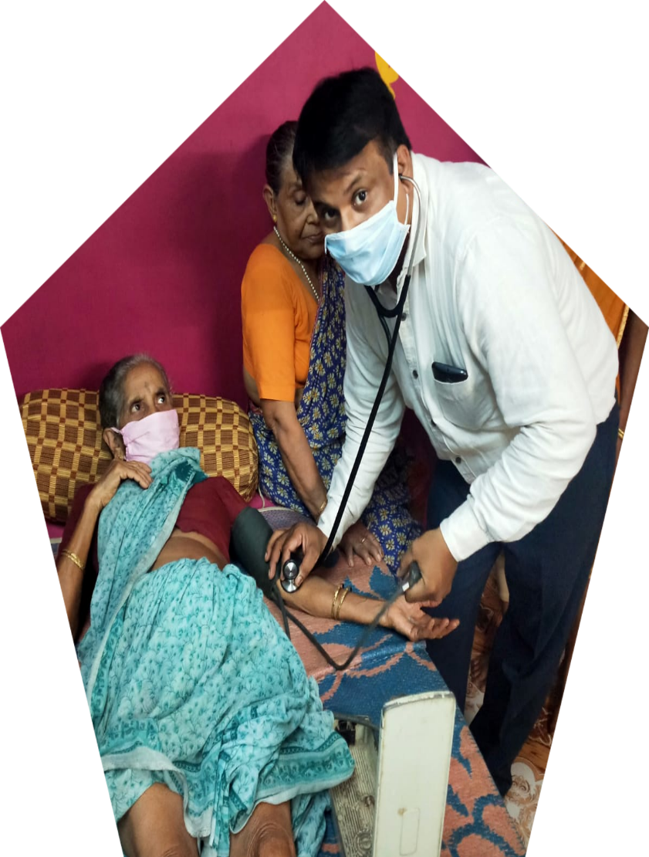

Mission
Transformation of Lives
Address poverty, illness, and lack of opportunities through focused and sustainable interventions

Slide 13
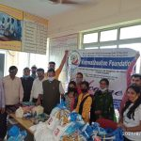
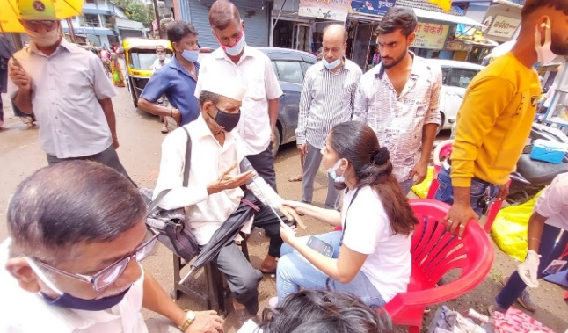
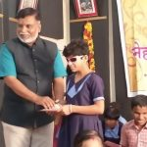
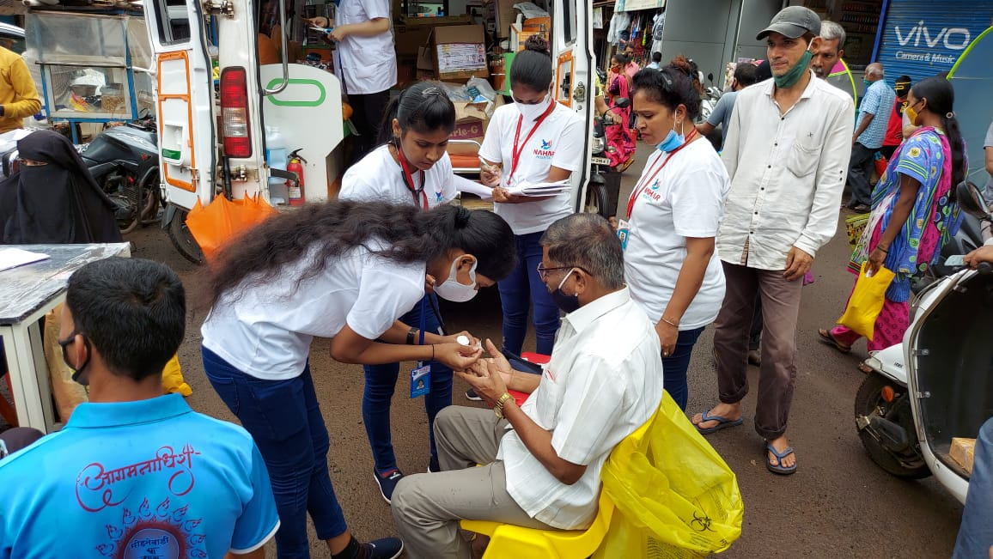
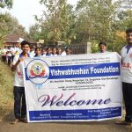
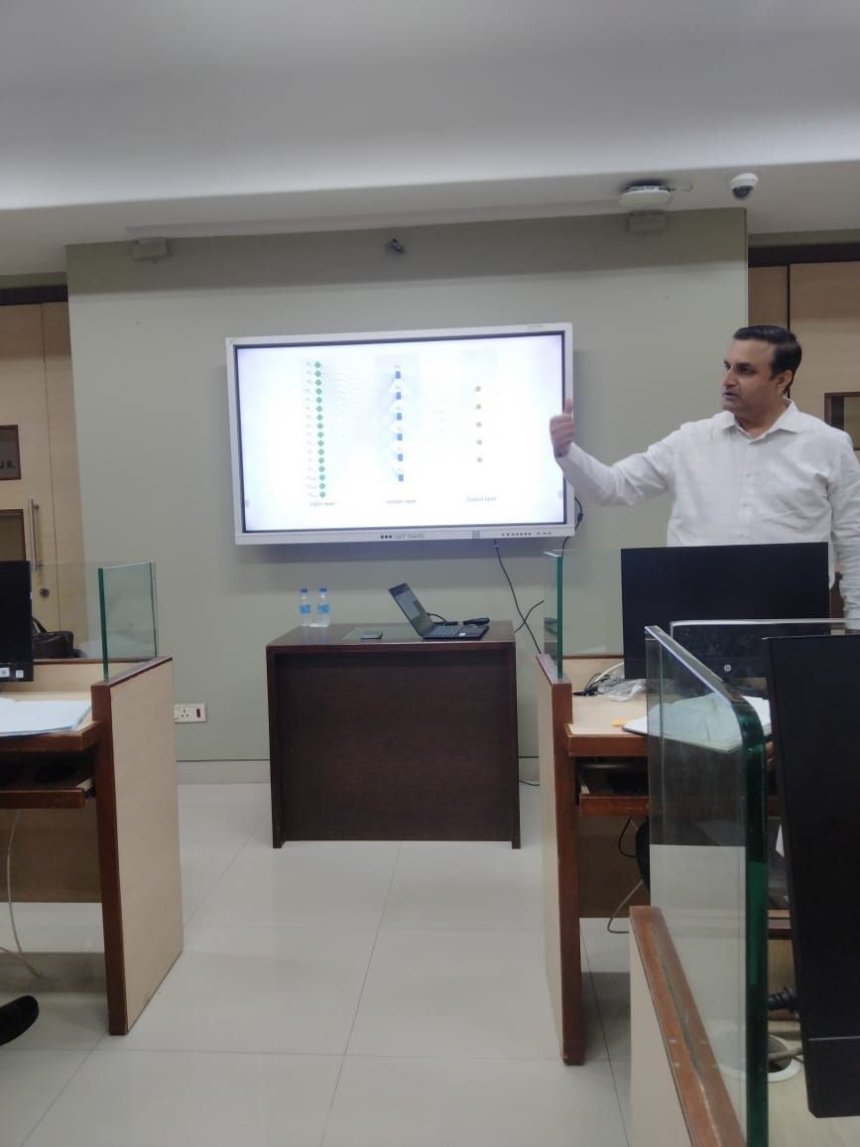
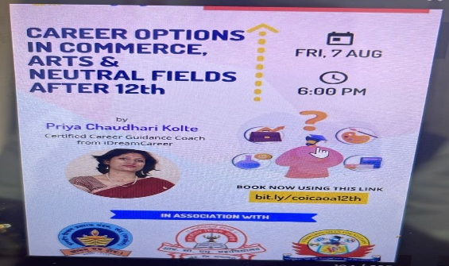

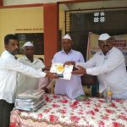
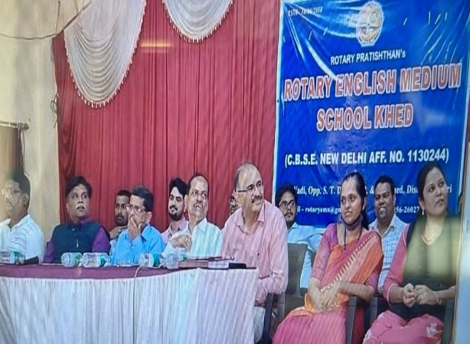
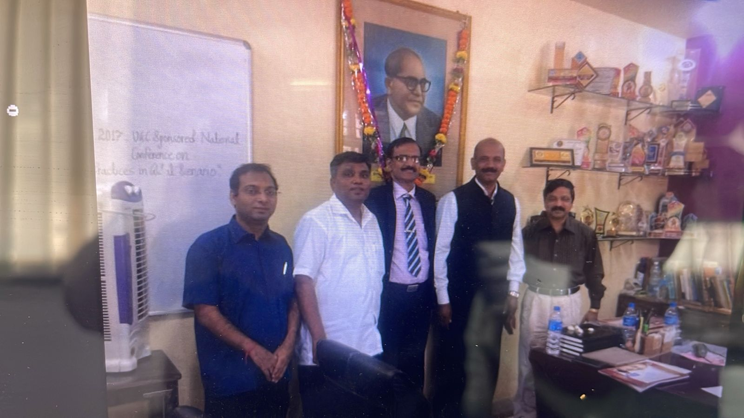
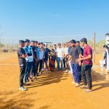
05
Unique Activities (2018-2024)

Slide 14
Key Activities
Activity List
Inspirational lecture at Mahatma Jyotiba Phule Dr. Babasaheb Ambedkar College
Celebrations and student guidance programs
Computer training workshops for students
Career and employment guidance for students from rural areas
Quality enhancement programs for Class 10 and 12 students at various institutions
Sports competitions
"Police Friend" program
Awareness programs on women's education, COVID- 19, and environmental conservation
Blindness prevention program
Tree plantation, flood assistance, and distribution drives

Slide 15

Audit of Extension and Outreach Activities
06

Slide 16

Implemented Initiatives
Academic Development
Links to educational trust websites
Rural Development
LocationsNimgaon - Jali, Khed - Khonde
Green Practices
LocationI.C.S.College Khed
Health and Hygiene
Links to educational trust websites
Disaster Management
Madanbhai Sura Institute of Business Management - MSIBM

Slide 17
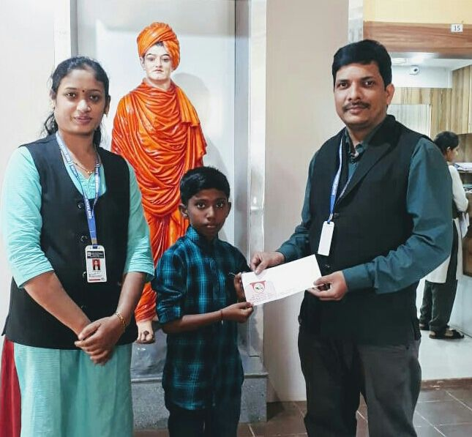
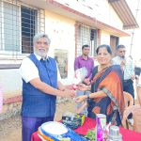
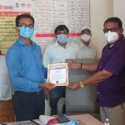
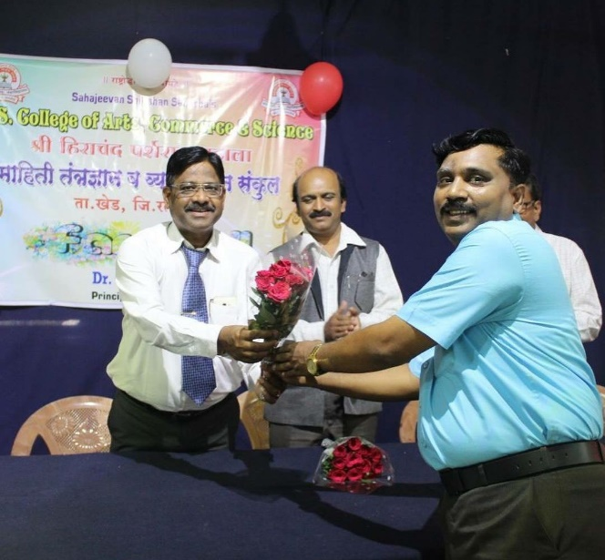
Awards Given for Different Categories
07

Slide 18

Recognition in Various Fields
Award List
01
Excellence Vishwa NGO, Excellence Vishwa Startup
07
Excellence Vishwa Professor, Excellence Vishwa Sarpanch
02
Excellence Vishwa Volunteer, Excellence Vishwa Youth Businessmen
08
Excellence Vishwa Non- Teaching Staff, Excellence Vishwa Artist
03
Excellence Vishwa College, Excellence Vishwa Hospital
09
Excellence Vishwa NAAC Co- ordinator, Excellence Vishwa Dancer
04
Excellence Vishwa Department, Excellence Vishwa Doctor
10
Excellence Vishwa Research Project, Excellence Vishwa Singer
05
Excellence Vishwa Principal, Excellence Vishwa Lawyer
11
Excellence Vishwa Team (Game), Excellence Vishwa Agriculture Firm
06
Excellence Vishwa Vice Principal, Excellence Vishwa Gram Panchayat
12
Excellence Vishwa Player (Game), Excellence Vishwa Farmer

Slide 19

Income Statement
08

Slide 20
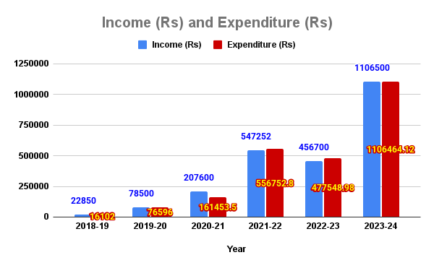
Detailed Financials
Financial
Statements

Slide 21

Research Grants Awarded
09

Slide 22
Supported Projects
Notable Projects
Addressing Malnutrition in Rural Schools Through Mid- Day Meal, Amit Jadhav,
Analyzing the Impact of Microfinance on Rural Livelihoods, Sudesh Kadam
01
02
Digital Literacy Training for Underprivileged Youth, Dr. R.B. Patil
Sustainable Farming Practices for Smallholder Farmers, Dr. Hiren Dand,
03
04
A Study of Adult Education and Measures to be taken
Dr. Sharayu Gupte
Analysis of Problem Fact by Fisherman
Ms. Manali Haldankar
05
06
Feasibility of Railway station of the Uran area of Navi Mumbai
Dr. Minakshi Gupta
07

Slide 23

E-Book Publication Summary
10

Slide 24
Research E-Books
Publication Details
Research Vishwa, ISBN: 9781387935345
Research Vishwa, ISBN: 9781387371112
Research Vishwa, ISBN: 9781300699828

Slide 25

Online Workshop Seminar Conducted
11

Slide 26
Workshop Details
Research Methodology,
By Dr. Thiru,
Participation 89
How to Write Research Paper and Research Proposal,
by Dr.A.M.Shaikh,
Participation96
Use of ICT in Research,
by Mr. V.I. Pujari, Participation 90
Seminar Topics

Slide 27

Visits of Renowned Persons
12

Slide 28
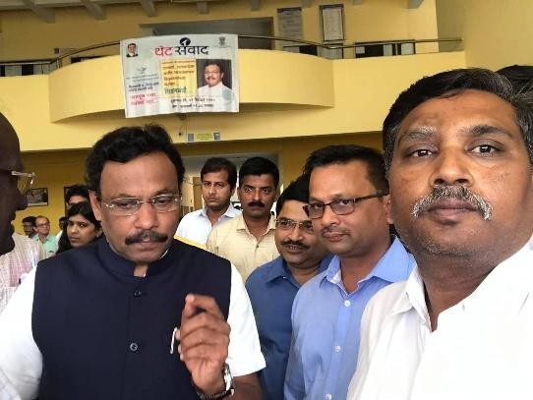
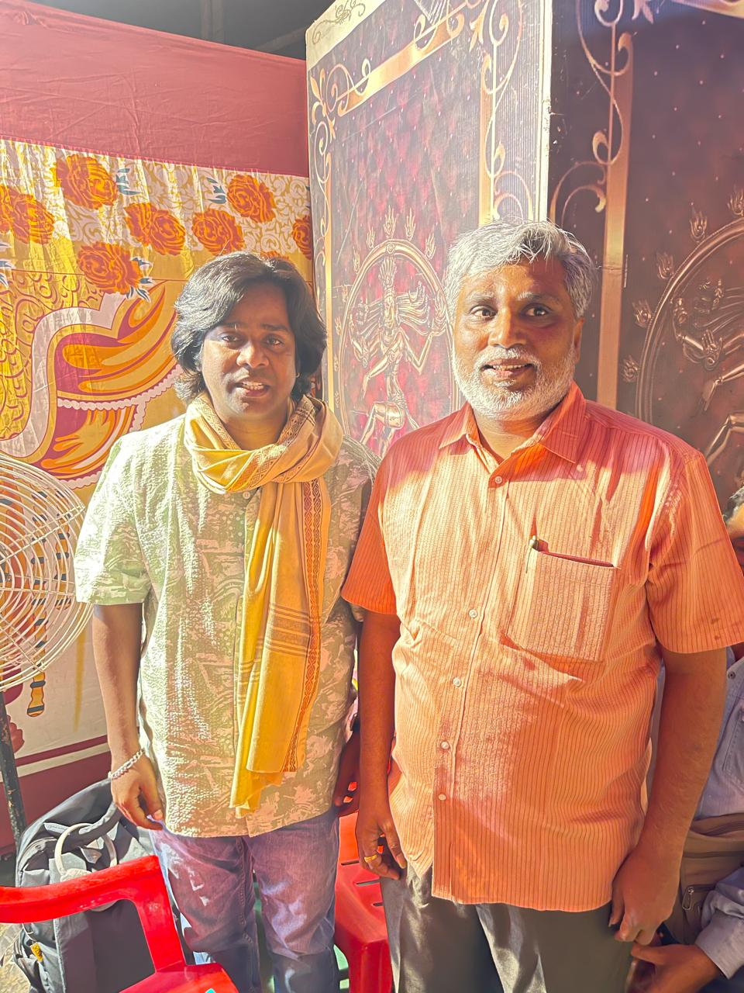
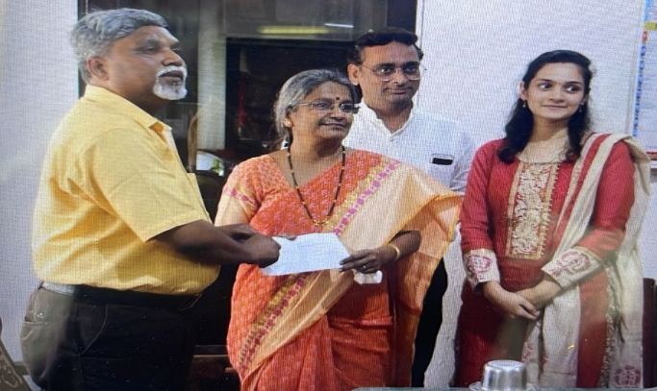
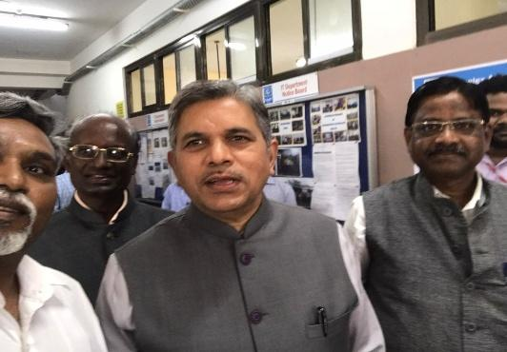
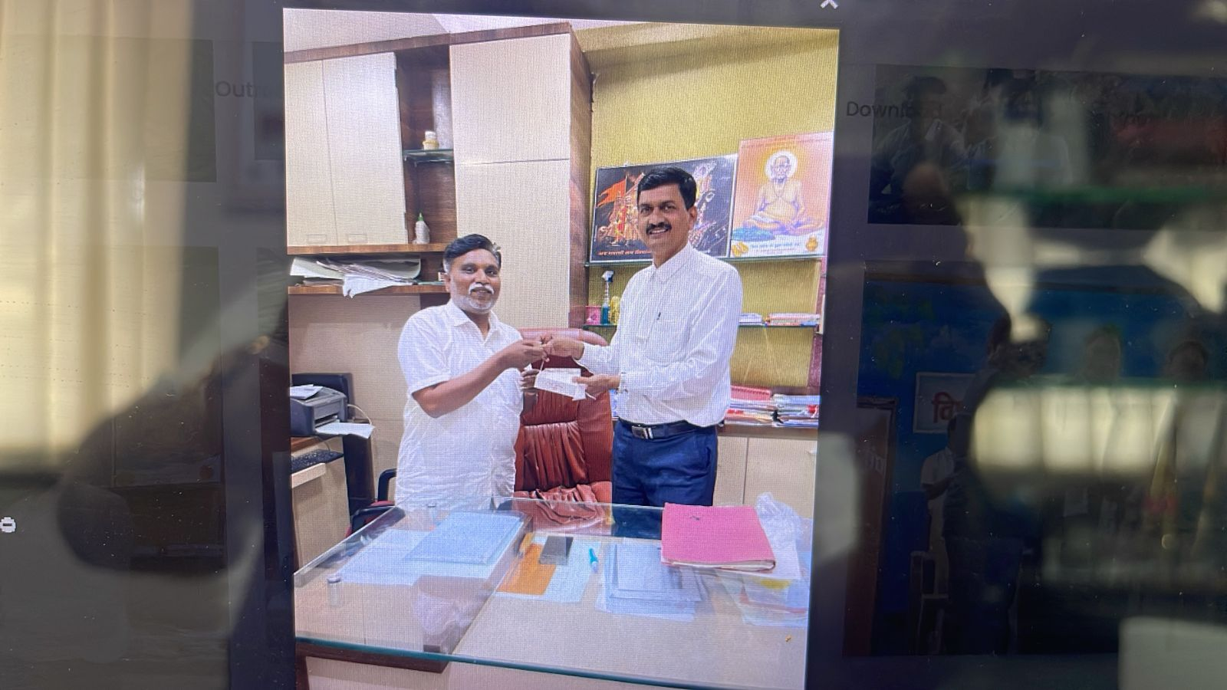
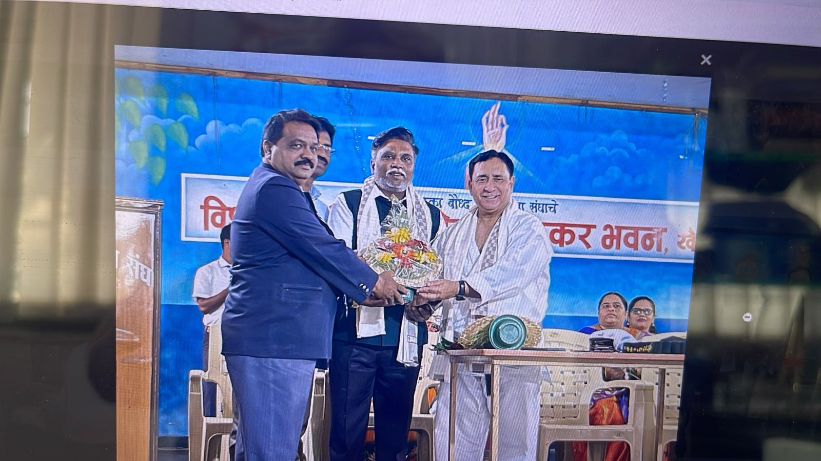
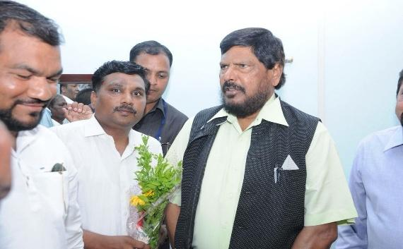
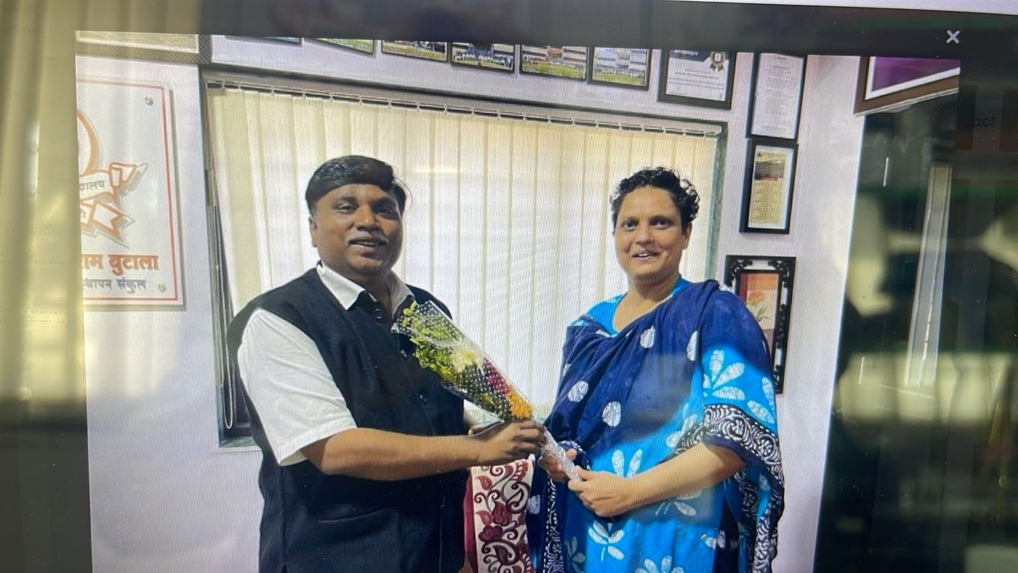
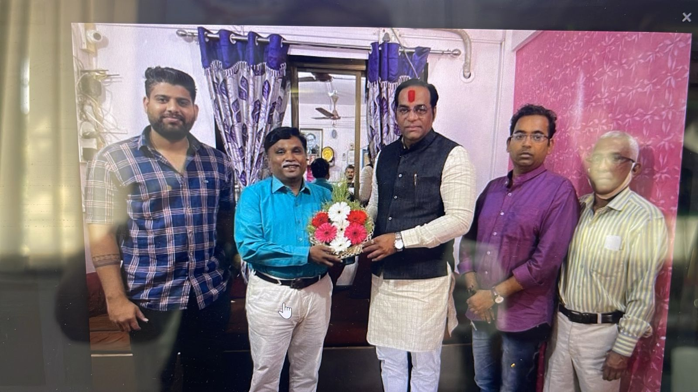
Documented Visits of Renowned

Slide 29

Proposed Initiatives
13

Slide 30

Awareness of Digital Literacy
Objective
Equip community members with basic digital skills
Target AudienceYouth, women, and senior citizens
Activities, Workshops, training sessions, tutorials
Resources Needed Computers, projectors, trainers, Wi- Fi- enabled classrooms
Outcome MeasurementParticipation numbers, skills improvement surveys
Proposed Cost:
25 Lakh Rupees

Slide 31

Awareness of De-Addiction
Objective
Reduce substance abuse
Target Audience Individuals and families
ActivitiesCounseling sessions, workshops, support groups
Resources NeededPsychologists, counselors, audio- visual aids
Outcome Measurement Participation rates, recovery testimonials
Proposed Cost:
5 Lakh Rupees

Slide 32

Awareness of Environmental Sustainability
Objective
01
02
03
Promote eco- friendly practices
Target AudienceSchool students, farmers, and urban residents
Activities Waste segregation, composting workshops, tree plantation drives
06
05
04
Proposed Cost:
10 Lakh Rupees
Outcome MeasurementTrees planted, waste reduction reports
Resources NeededSaplings, cleaning kits, volunteers, expert trainers

Slide 33

Awareness of Road Safety
Objective
Reduce accidents and promote traffic discipline
Target Audience Students, drivers, and general commuters
Activities Seminars, road safety exhibitions, competitions
Resources Needed Traffic police collaboration, printed safety guidelines
Outcome Measurement Reduction in accidents, community feedback
Proposed Cost:
8 Lakh Rupees
1.
2.
3.
4.
5.
6.

Slide 34

Awareness of Cyber Security
Objective
01
Safeguard against cyber threats
02
Target Audience Students, small business owners, and families
03
Activities Sessions on cybersecurity, guides distribution, safe online practices
04
Resources NeededCybersecurity professionals, IT equipment
05
Outcome Measurement Changes in online behavior, reported incidents
06
Proposed Cost:
30 Lakh Rupees

Slide 35

Senior Citizen Medical Camp
Proposed Cost:
3 Lakh Rupees
Outcome Measurement Number of senior citizens served, health improvements
Objectives
Resources Needed Doctors, paramedics, medical equipment, medicines
Activities Medical check- ups, medicine distribution, awareness sessions
Provide essential healthcare services to senior citizens
Target Audience Senior citizens

Slide 36

Awards
Objective
Recognize contributions to community development
Target Audience Social workers, educators, organizations
Activities, Nomination, Evaluation, Awards ceremony, Media publicity
Resources Needed Award trophies, certificates, event management team
Outcome Measurement Number of awardees,
Project visibility
Proposed Cost:
12 Lakh Rupees

Slide 37
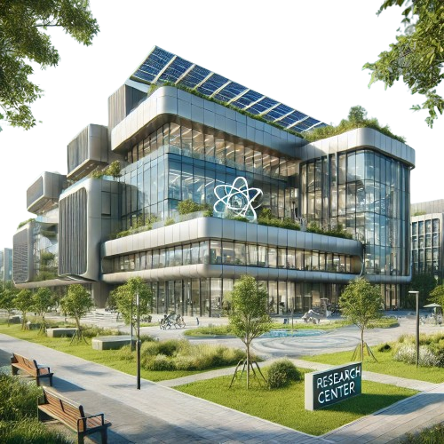
Research Building Proposal (2000 sq ft)
Objective
Resources Needed Funding, research equipment, maintenance staff
Outcome Measurement Research projects, partnerships, community benefits
Establish a research facility
Location Central area
Activities Allocate spaces, partner with institutions, workshops
Proposed Cost:
1.2 CR Rupees

Slide 38
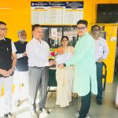
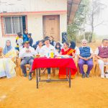
NGO Document Details
14

Slide 39
Registration and Certification
Documentation List
Registration NumberMaharashtra/282/2018/Ahmednagar Date:10 May 2018
Darpan IDMH/2019/0240269
PAN CardAADTV0950B
Income tax 12A CertificateAADTV0950BE2021401
Vishwabhushan Foundation Certificate NumberF21077
Income tax 80G CertificateAADTV0950BF2021401
Approval Letter number for form CSRCSR00007453
CA CertificateAHM/519869/TA/22

Slide 40
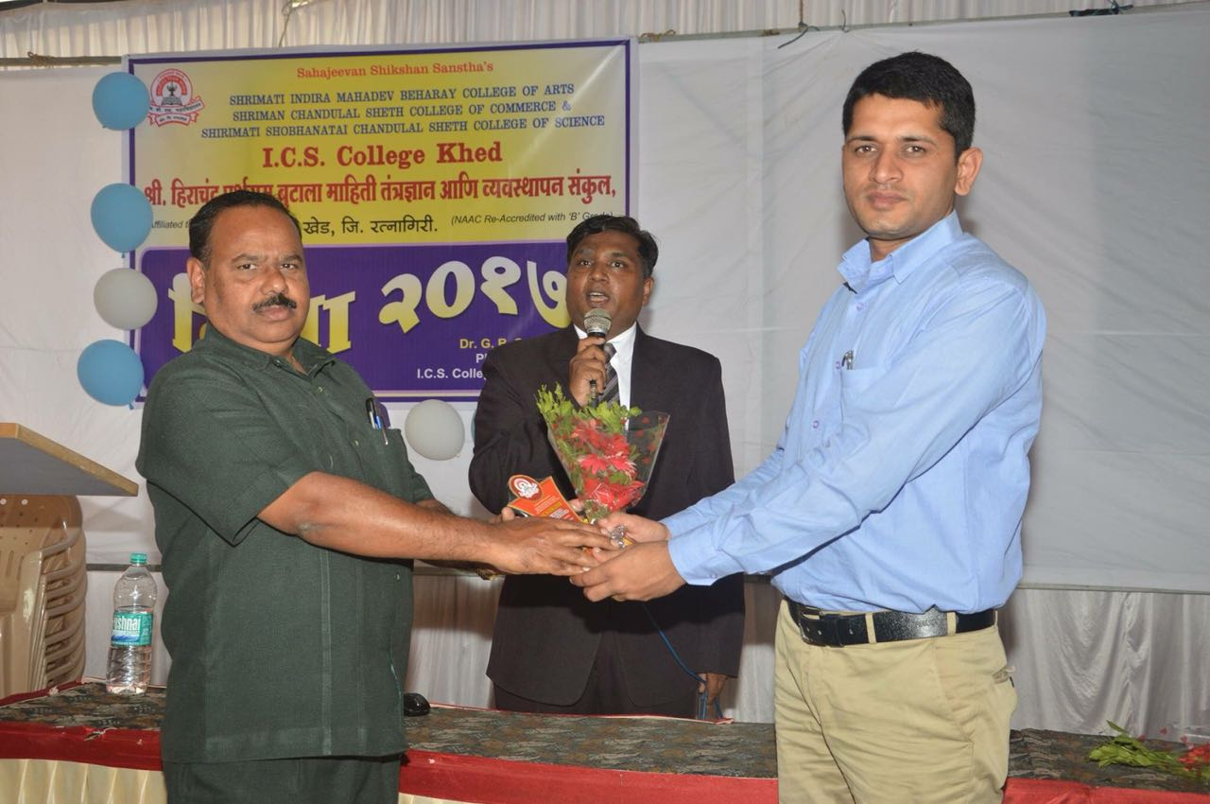
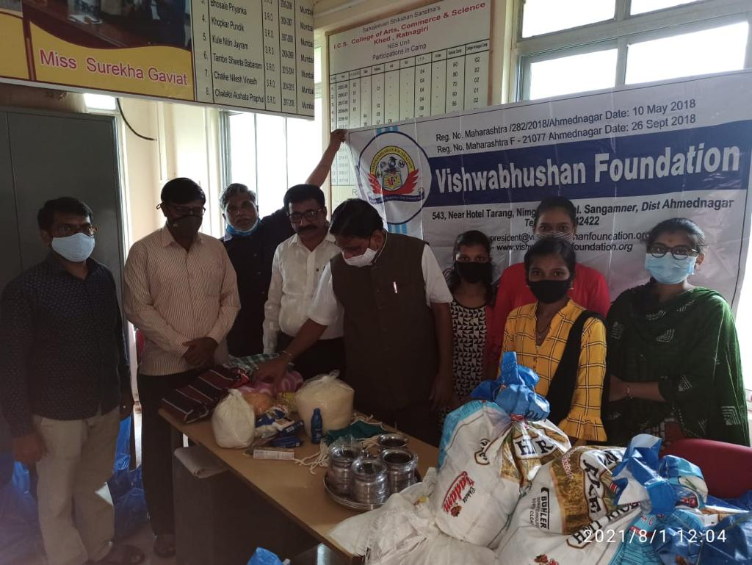
Conclusion
15

Slide 41
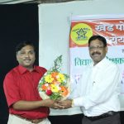
Foundation's Dedication
Commitment to Society
Uplifting underprivileged sections through healthcare, education, research, and socio- economic development

Slide 42
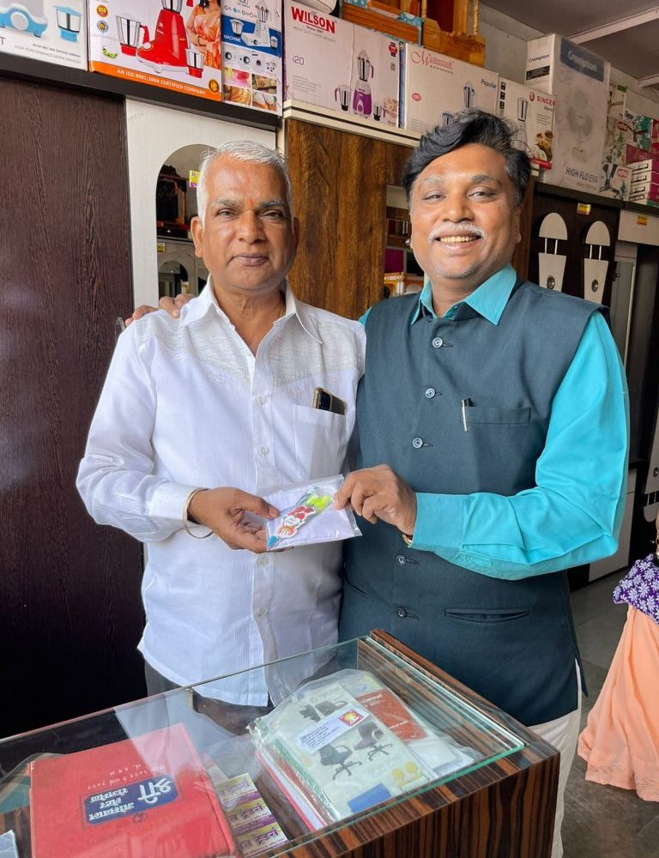
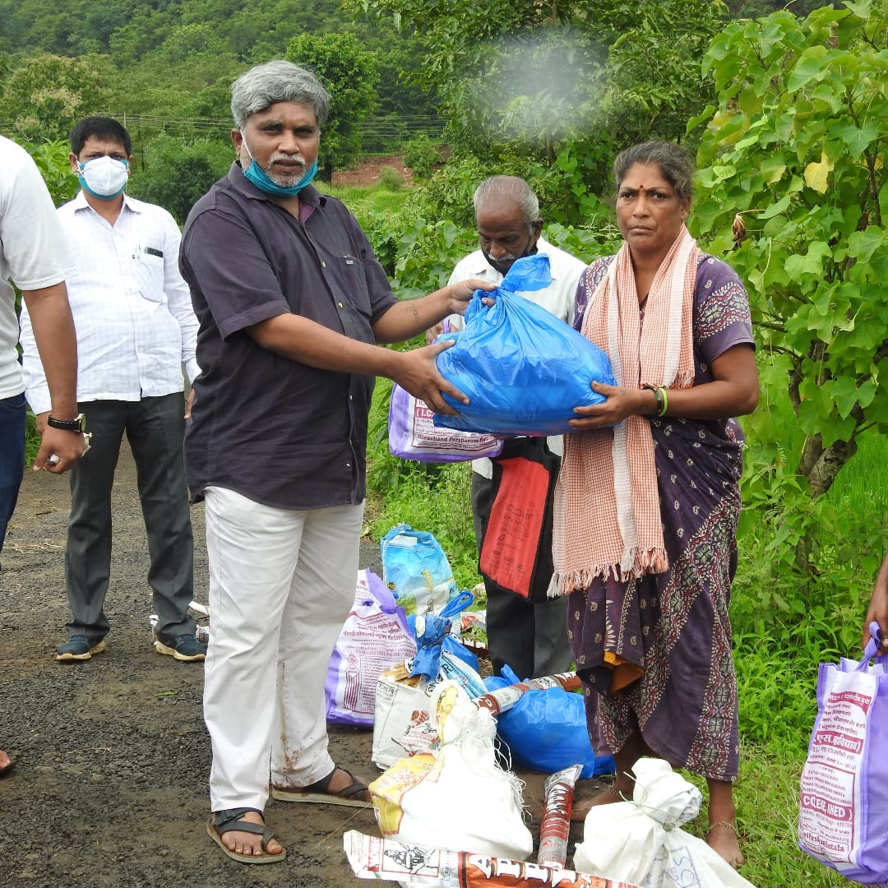
Contact Information
16

Slide 43

Details
Address and Website
https://vishwabhushanfoundation.org/
Vishwabhushan Foundation,
C/o. Dr. Sachin Shankar Bhosale, Near Hotel Tarang,
Kolhar Ghoti Highway,
At. Nimgaon Jali,
Tal. Sangamner, Dist. Ahmednagar

Slide 44

Thanks
Dr Sachin Bhosale
Report Date：22.01.25

